Slide 1

Second Advance
PSIFI
Jose Carlos Pacheco Sanchez - A01702828
Manuel Yafté Gallegos López - A01702980
Hugo David Franco Ávila - A01654856
Valeria Nicole Barra Maldonado - A01653899

Slide 2
Analysis of the user tasks
We used online surveys to gather information.
The analysis of the results we got are as follows

Slide 3
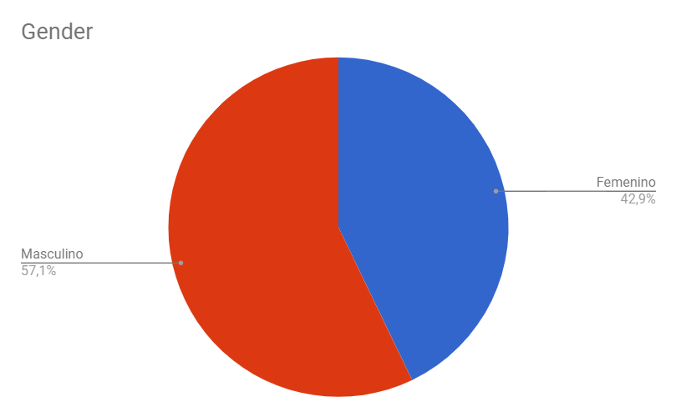
User responses analysis

Slide 4
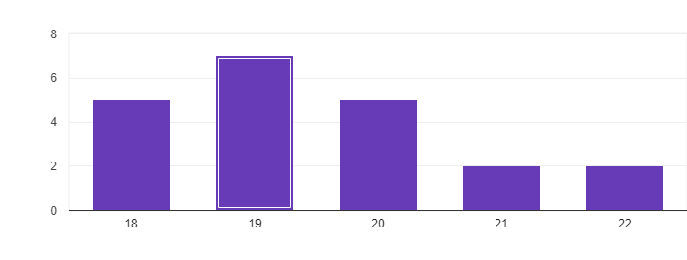
User responses analysis
Age

Slide 5
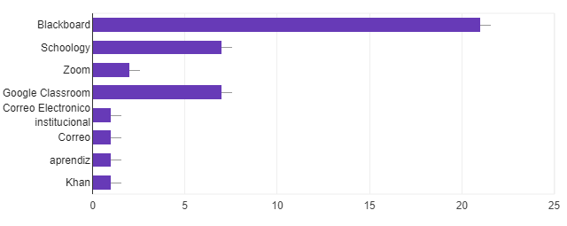
User responses analysis
Platform(s) the teacher uses to communicate

Slide 6
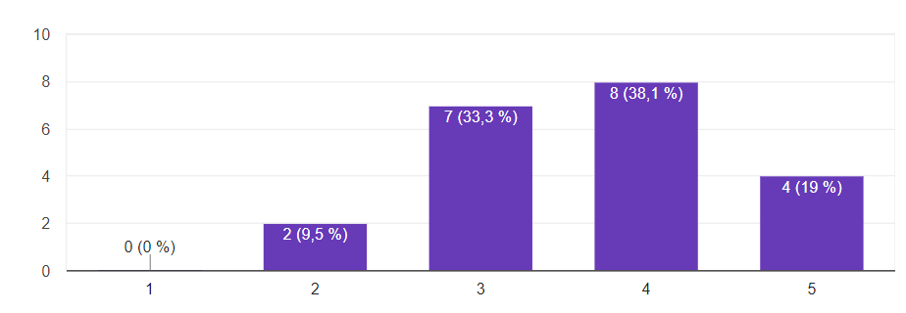
User responses analysis
From 1 to 5, how easy is it to navigate the websites you previously mentioned?

Slide 7
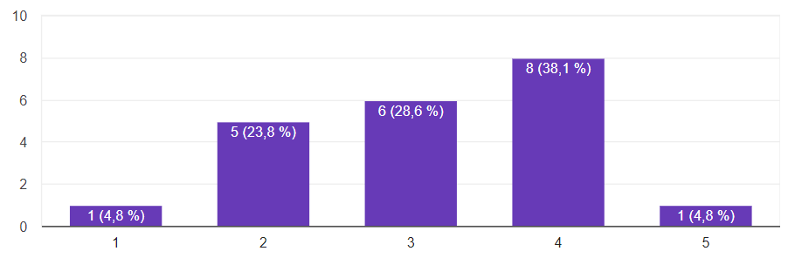
User responses analysis
From 1 to 5, how meaningful is the interaction you get with your teacher on said websites?

Slide 8
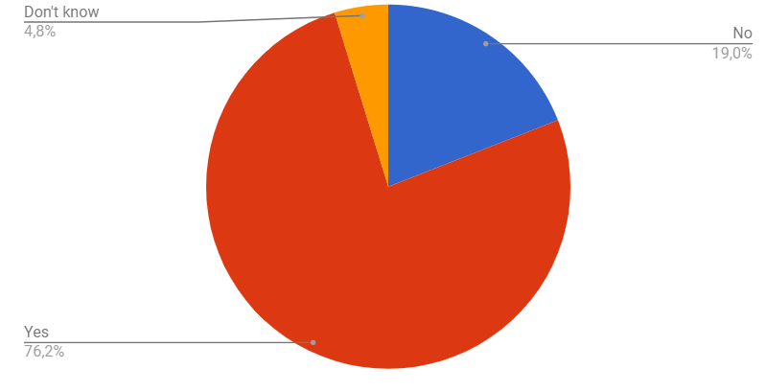
User responses analysis
Have you felt the need to review something you learned in previous semesters?

Slide 9
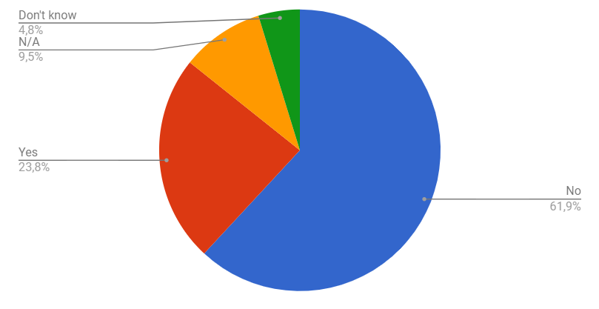
User responses analysis
Can you find information of previous courses you took in the websites you mentioned?

Slide 10
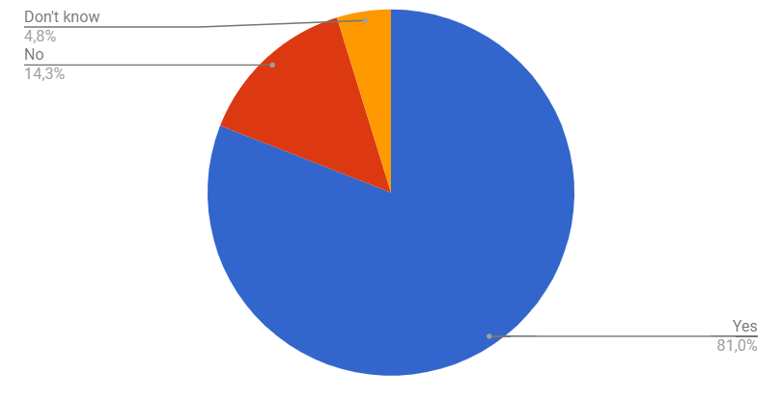
User responses analysis
Would you like to see information about the courses you are going to take in future semesters?

Slide 11
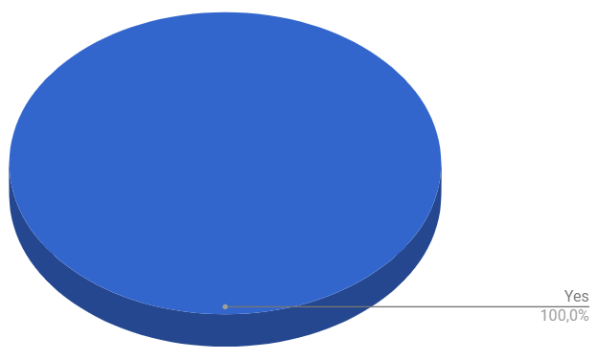
User responses analysis
Would you find it useful if other students could share useful information of the courses you are taking/are planning to take?

Slide 12
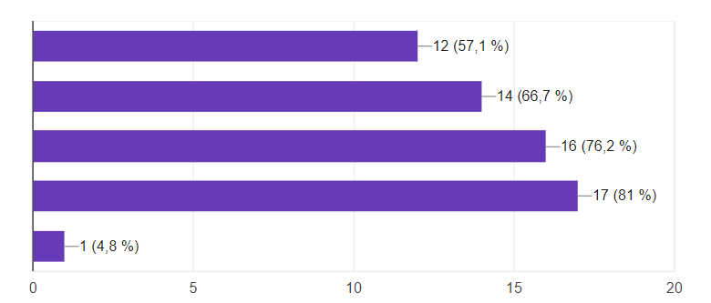
User responses analysis
Select the options you would like to see on a studying aid website.
a.
b.
c.
d.
e.

Slide 13
User responses analysis
Sharing of useful links and resources to study
b. Information classified by semester
c. Information classified by course
d. Having a Forum where students can discuss and solve doubts
e. N/A

Slide 14
Our response to user feedback
Users want to be able to review past or future content but are in most cases not able to do it, the main purpose of our website is displaying this information and useful links to students, so our idea makes sense.
Based on feedback, students want a space where they can either help or get help with their courses, so we are going forward with our idea of having a student forum where they can post information or doubts.

Slide 15
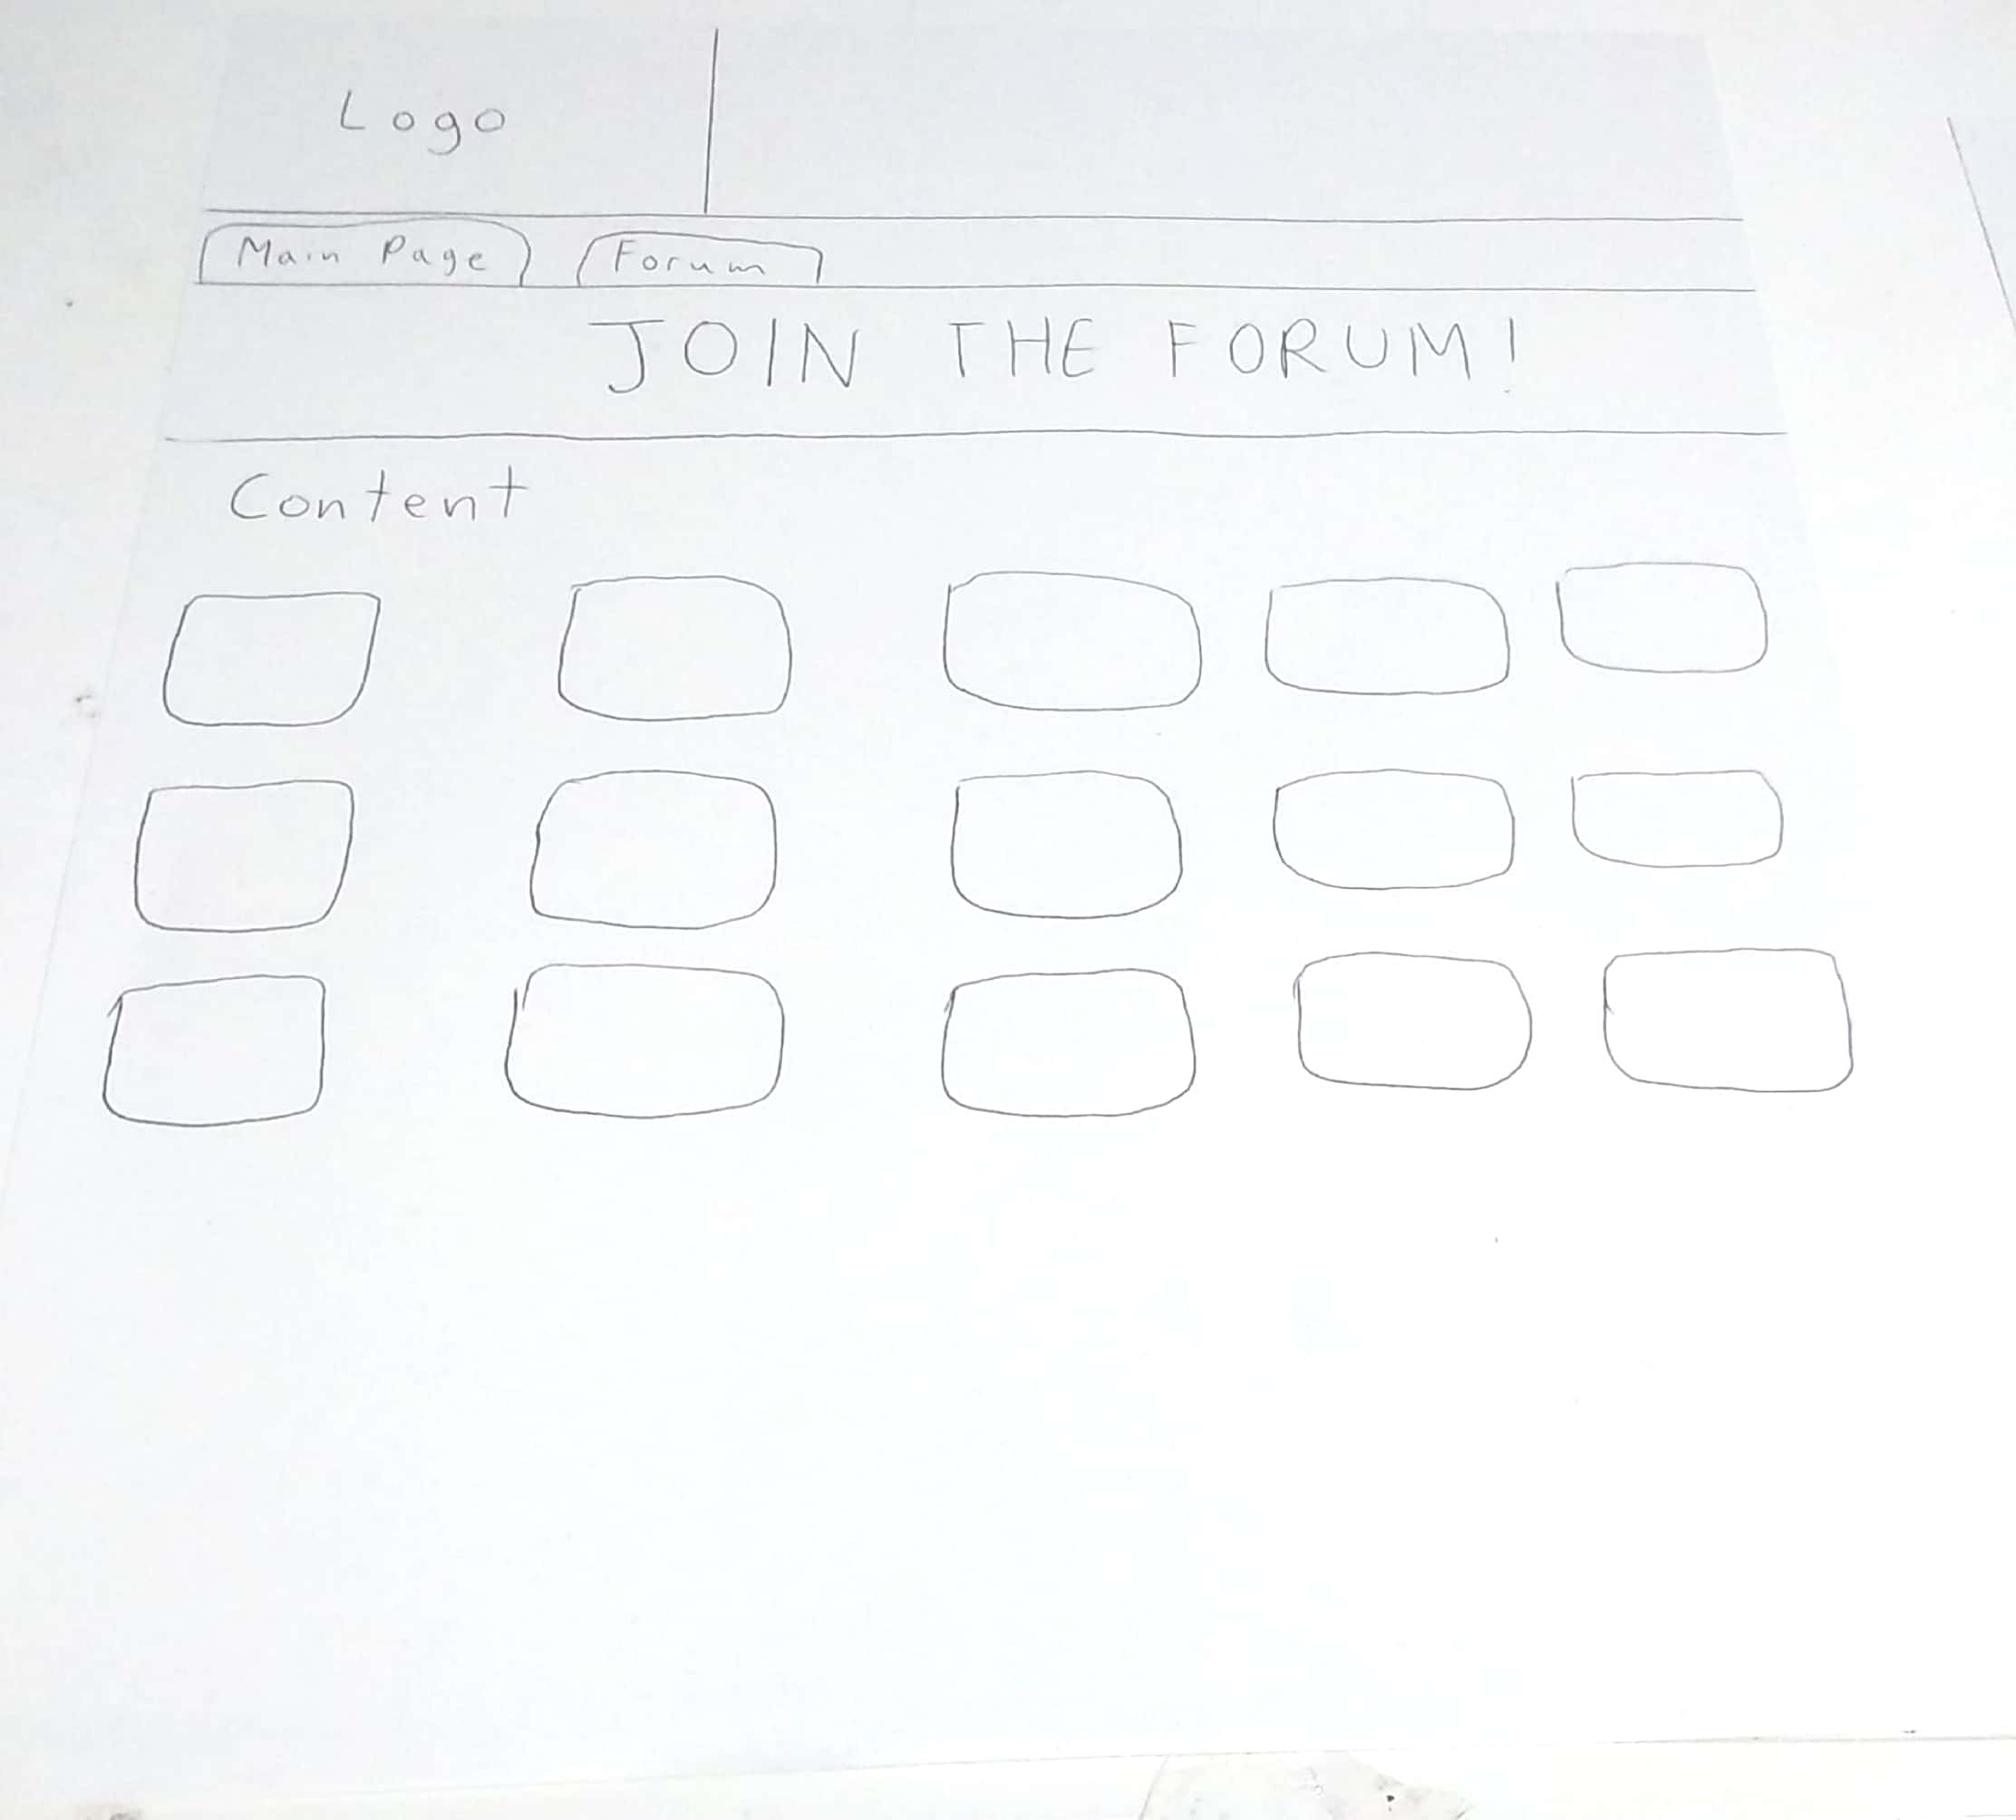
Prototype design

Slide 16
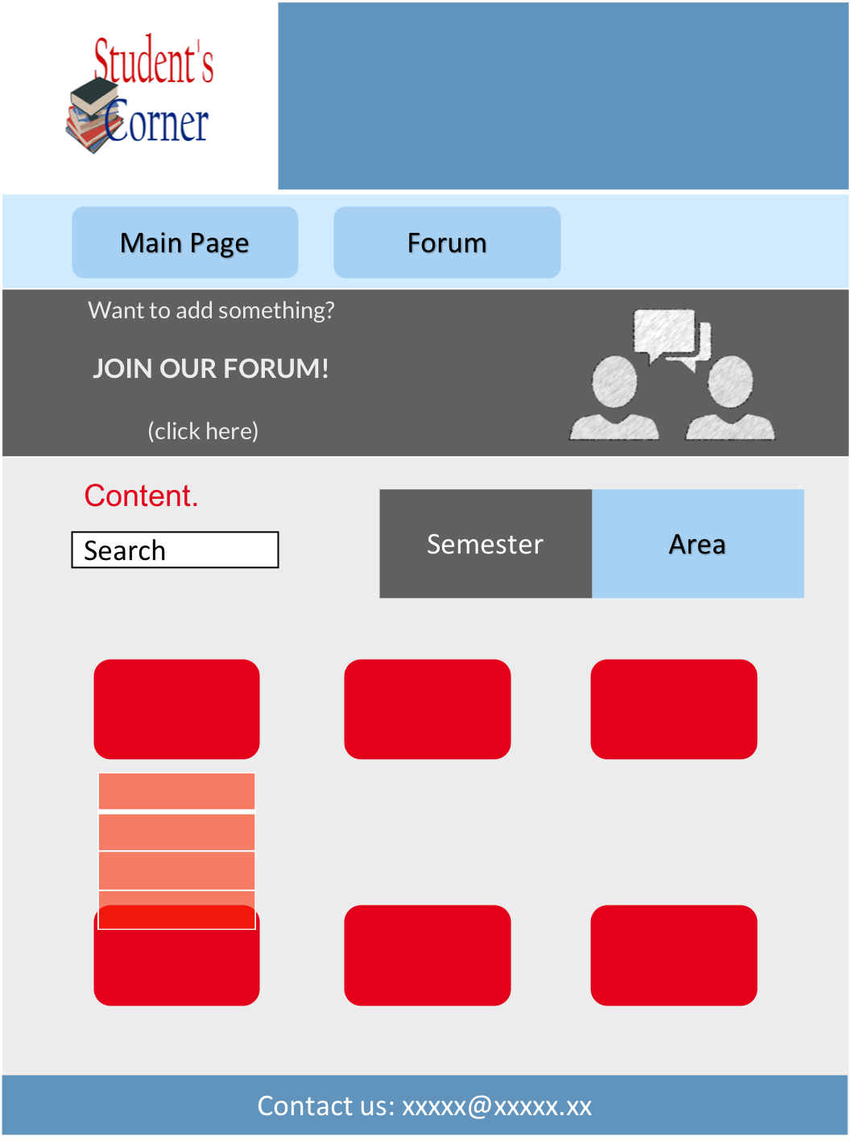

Slide 17
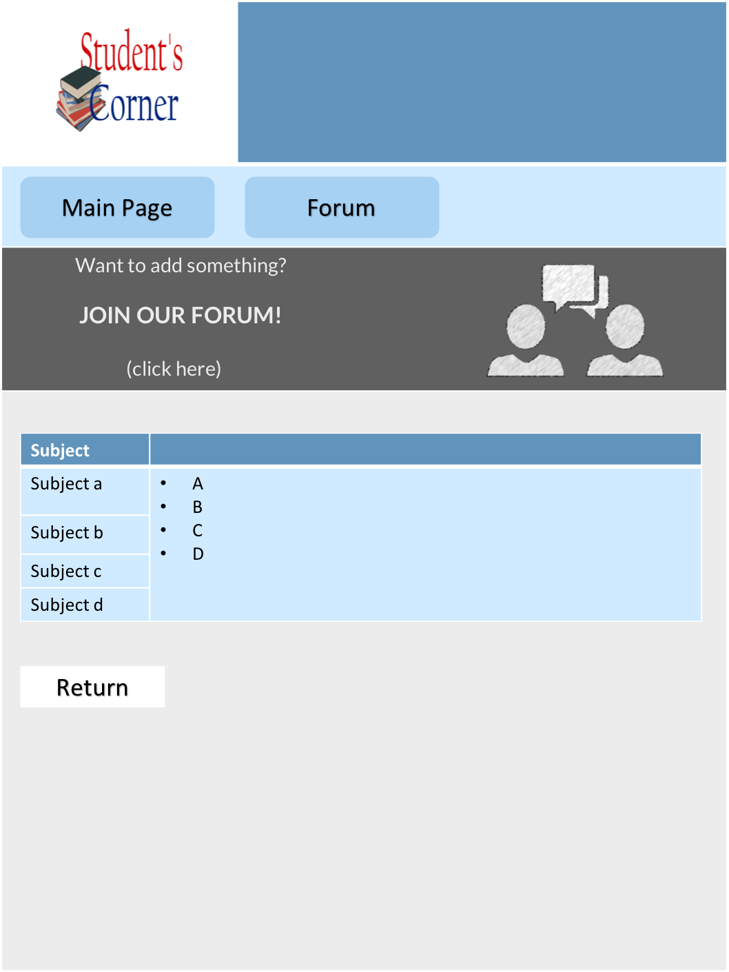

Slide 18
Analysis of the implementation of the interaction design principles in the designed system components

Slide 19



Strive to be consistent
Notes:
We’ll use lato font for the whole interface. Size vary

Slide 20




Search for universal usability
Notes:
Easy to use for everyone
Simple interface
Design focus on the user analysis

Slide 21

Mobile phone version
Instead of displaying a cascade list, it will send you to another page (this because a list might be small and difficult to read in a cellphone)

Slide 22

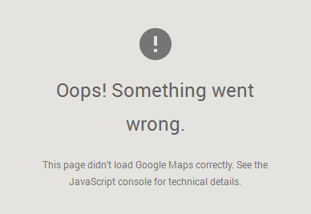
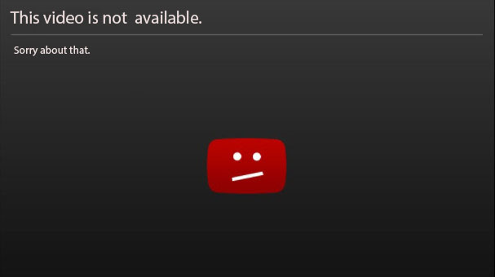
Provide feedback
Notes:
we will be providing feedback constantly about what the user does

Slide 23

Design a dialogue leading to an end
Identify the semester
Click on the subject
Post useful material or ask your questions
Notes:
achieve goals, the path to achieve goals is simple

Slide 24

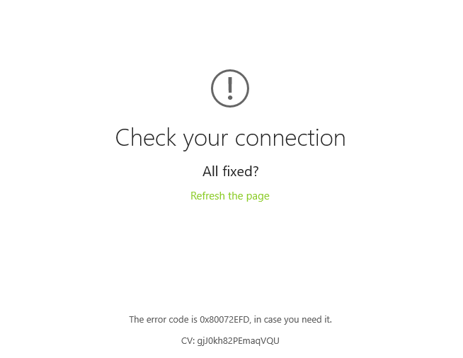

It is better to prevent errors
Notes:
Check before
always trying first
sending error messages if so

Slide 25


Allow undo
Notes:
It’s going to be possible to go backwards. So, if there is a mistake the user can go backwards and avoid the frustation

Slide 26

Give control to the user

Slide 27

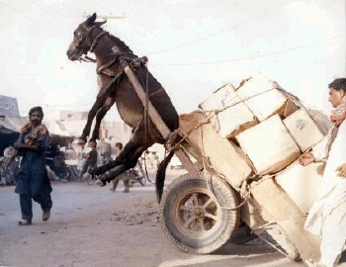
Avoiding overloading the user memory
Notes:
The only thing the user has to remeber is how to use the computer. the main menu is going to be simple

Slide 28

Emotional aspect

Slide 29

Positive:
Quick and easy
Certainty
Relief
Feedback
Error message
Balanced
Color
Organized

Slide 30
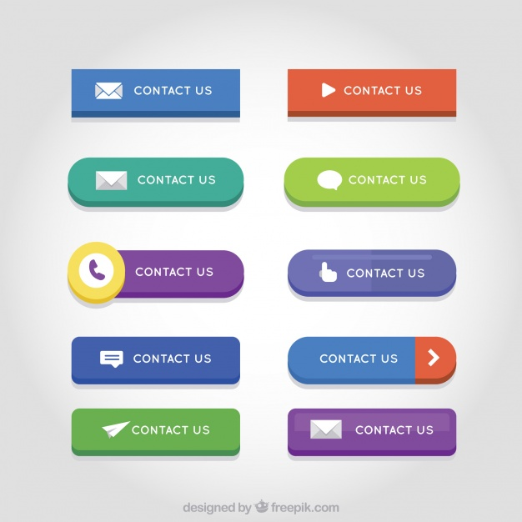

Frustration
Loading with percentage
Error pops (small)
Instructions
Alternative type of buttons
Instructions/support

Slide 31

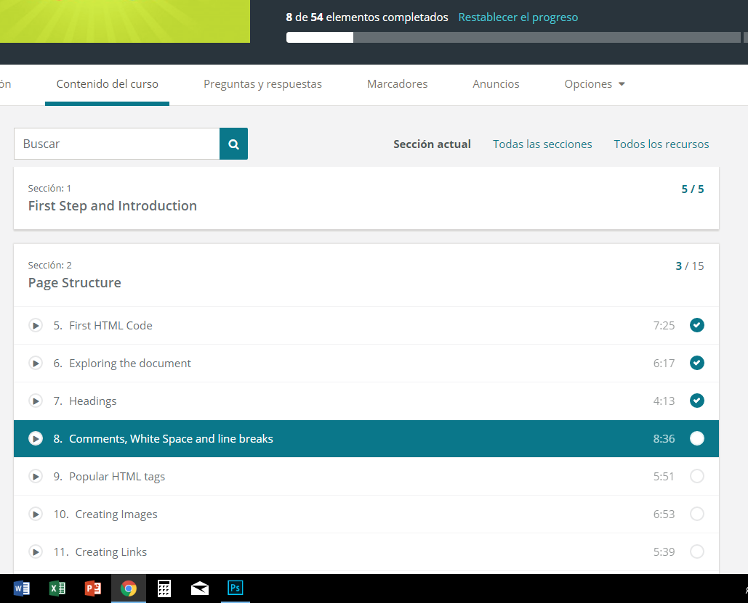
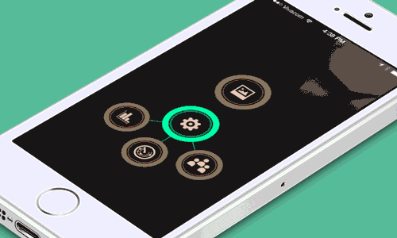
Persuasive technologies
Interactive design with all the subjects
Visual animations
Progress Bar, calendar Advice

Slide 32
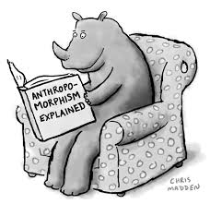

Anthropomorphism
Human-Computer → useful Tool

Slide 33

Virtual agents
In the case the user needs special instructions
or there is an error on the page, they could contact
with the developers.
If the error is simple, there would be first a small survey that will lend the user some tips to fix the problem

